Slide 1

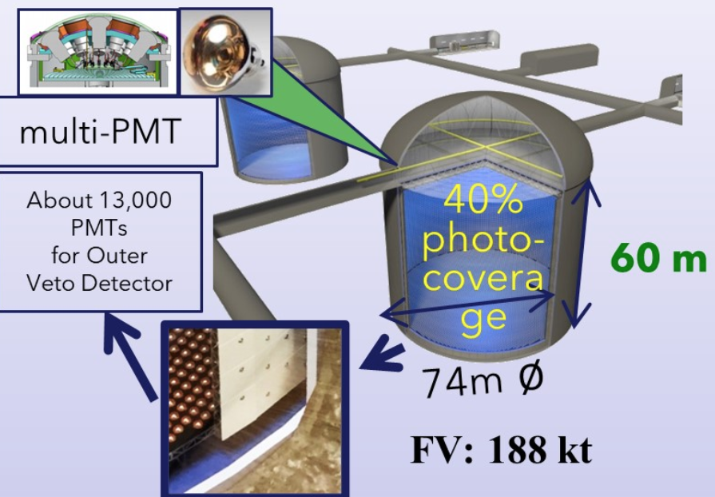

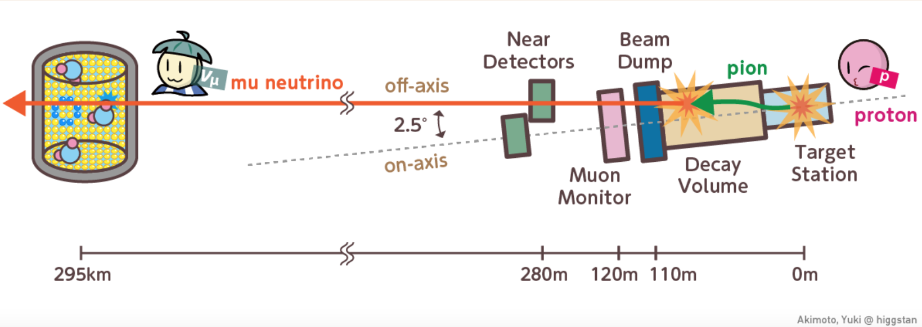
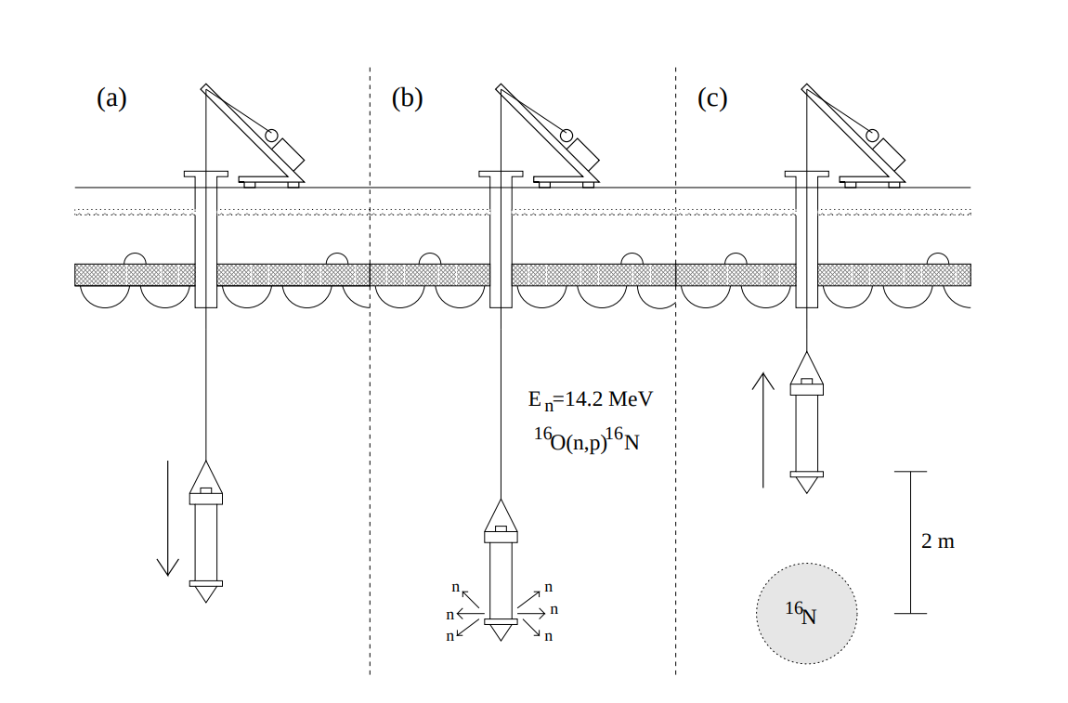
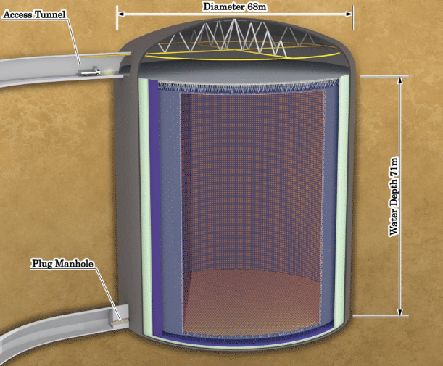
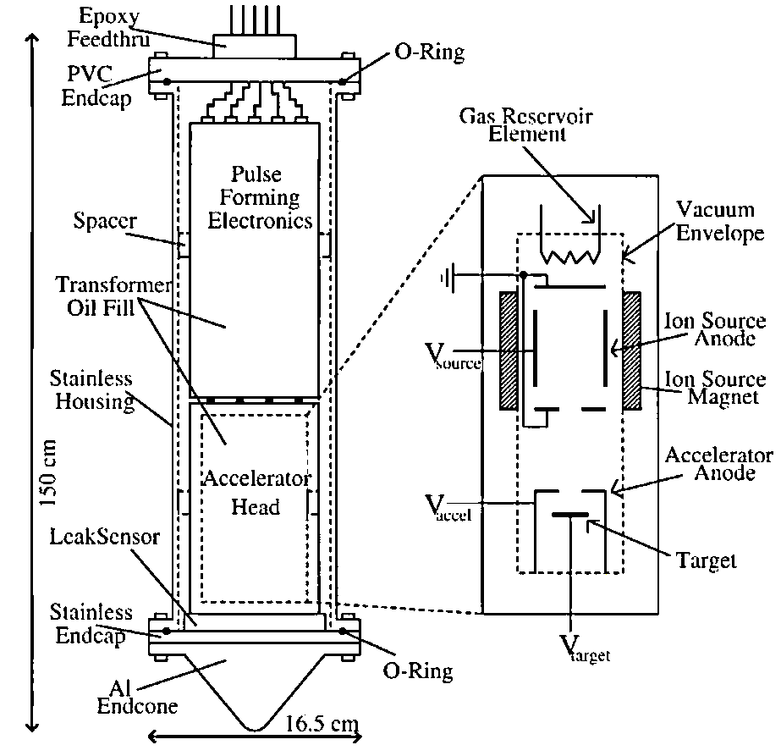
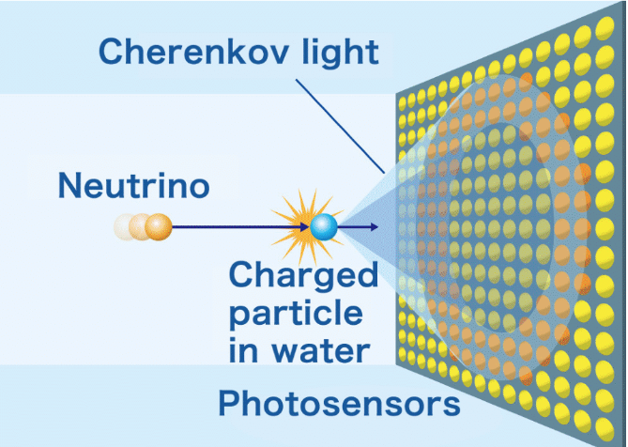
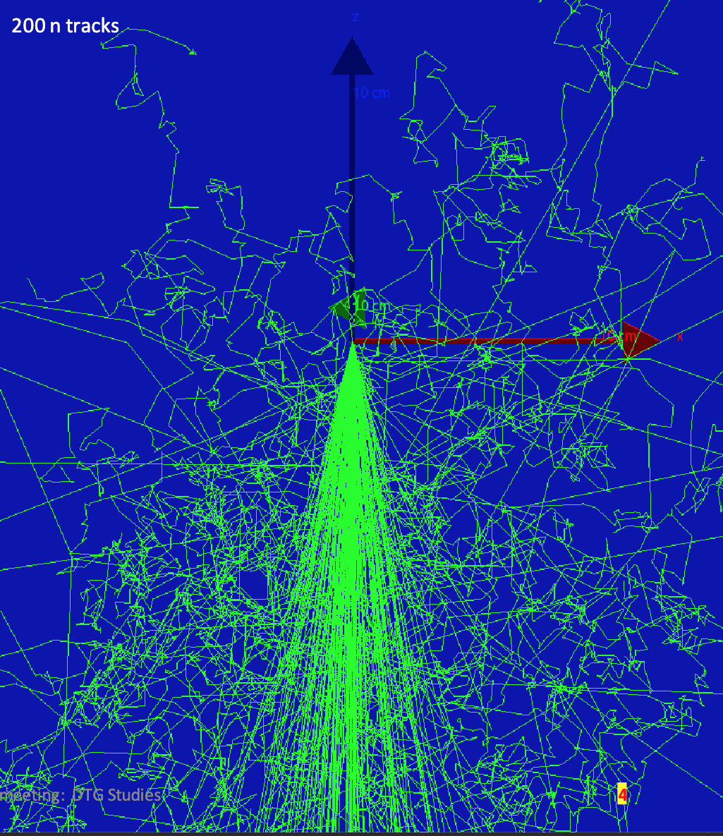
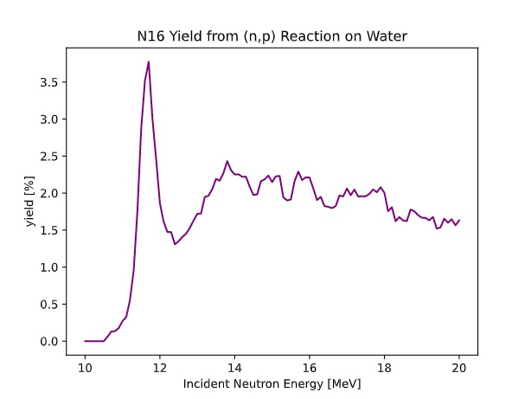
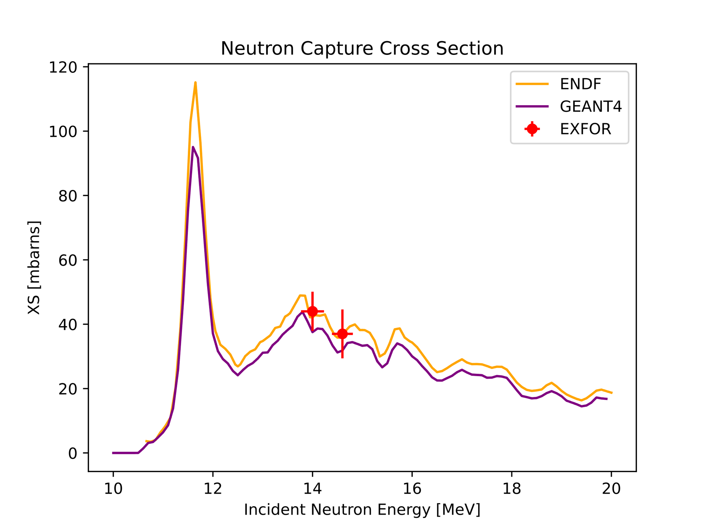
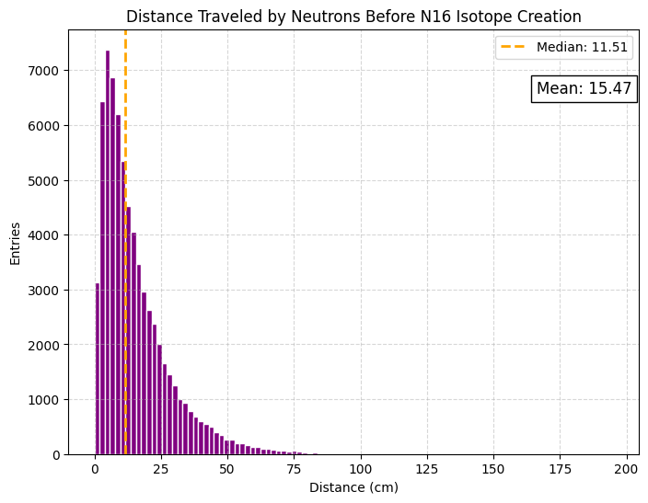
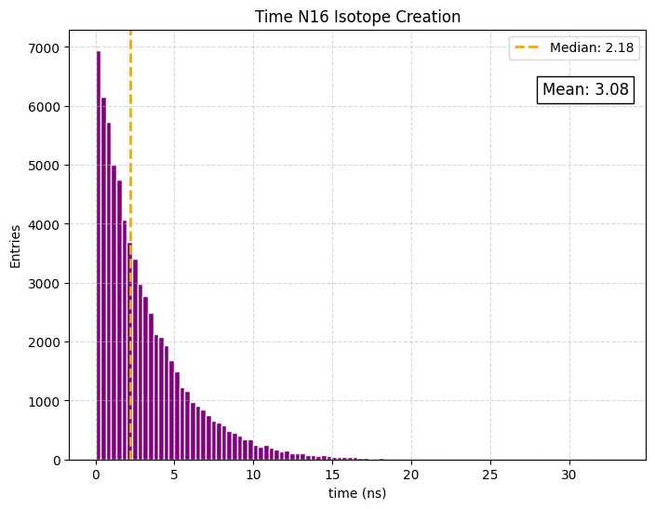
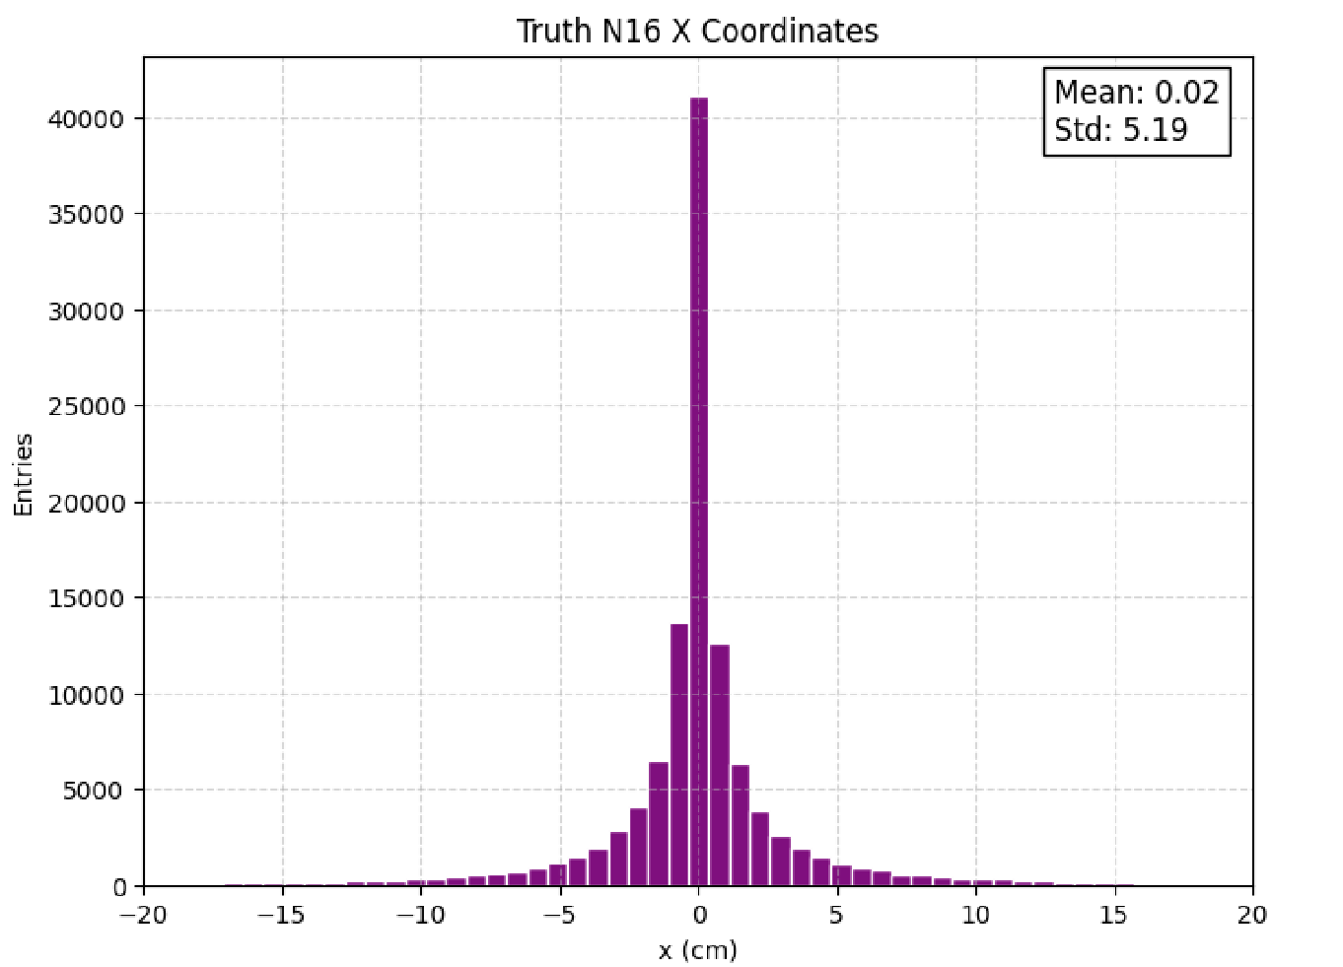
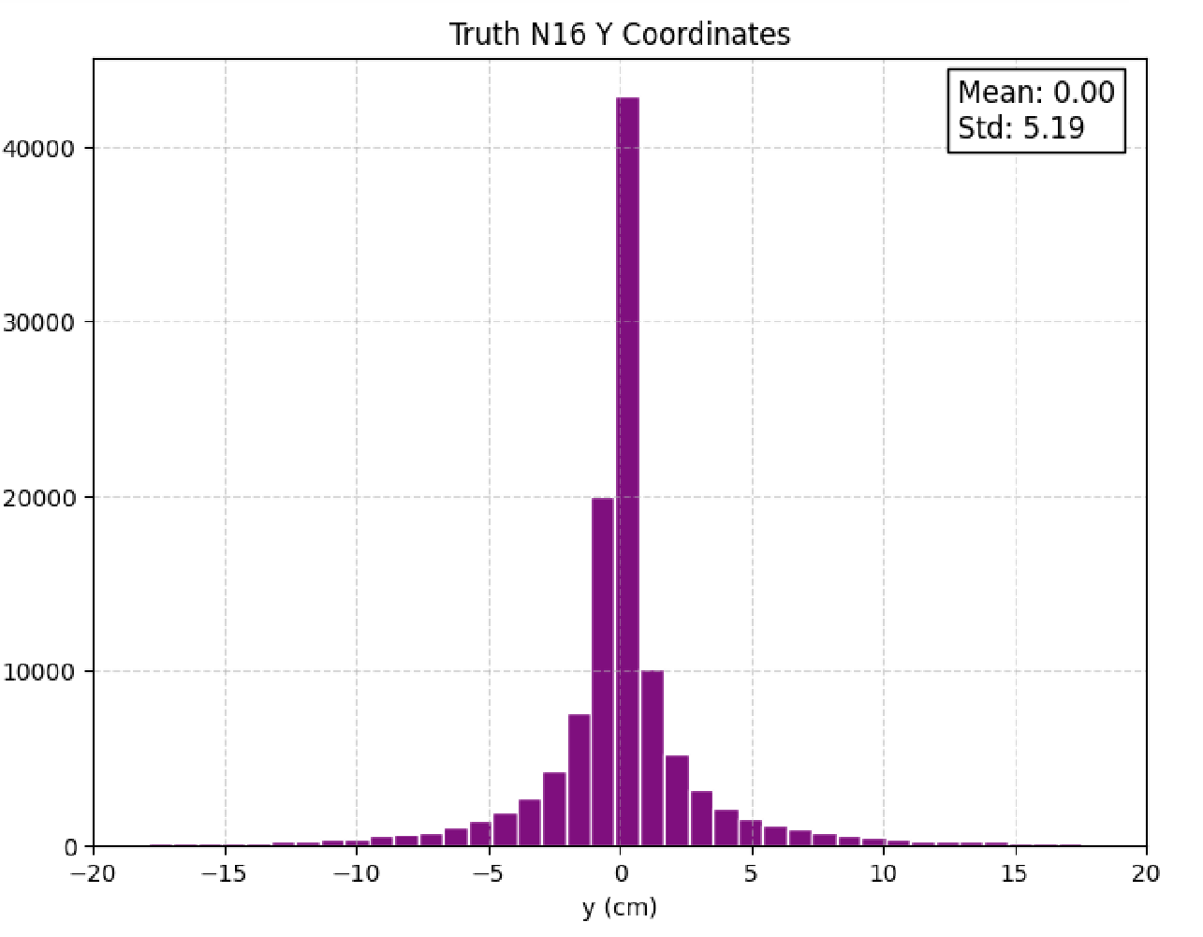

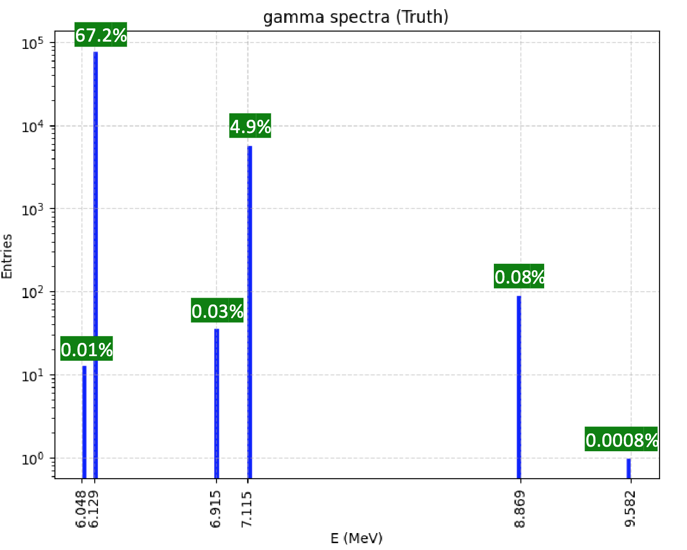
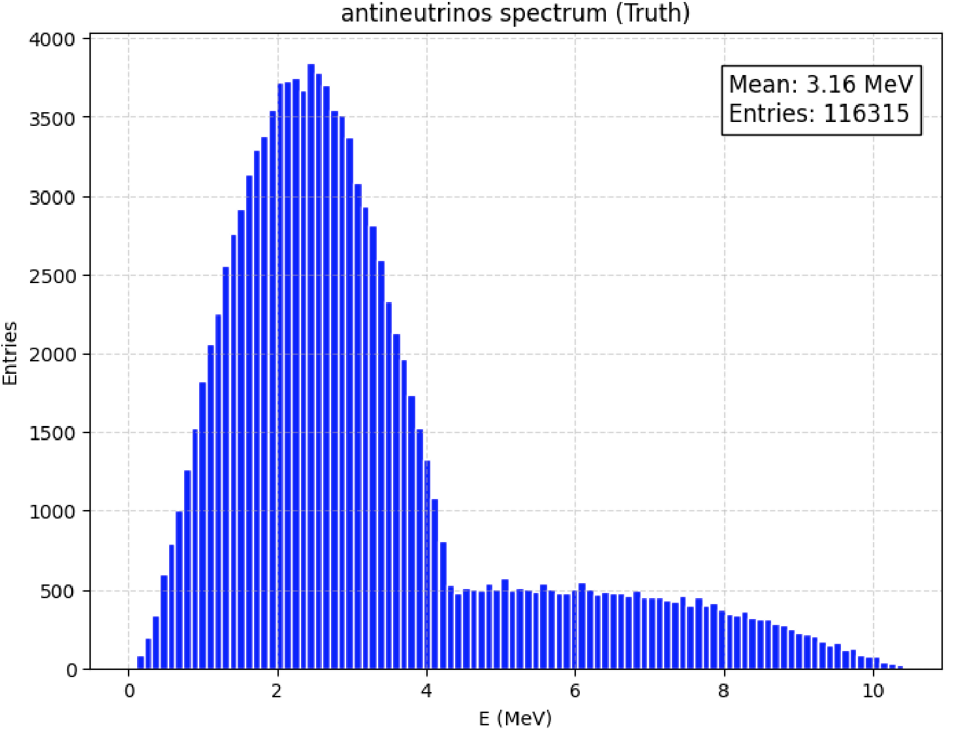
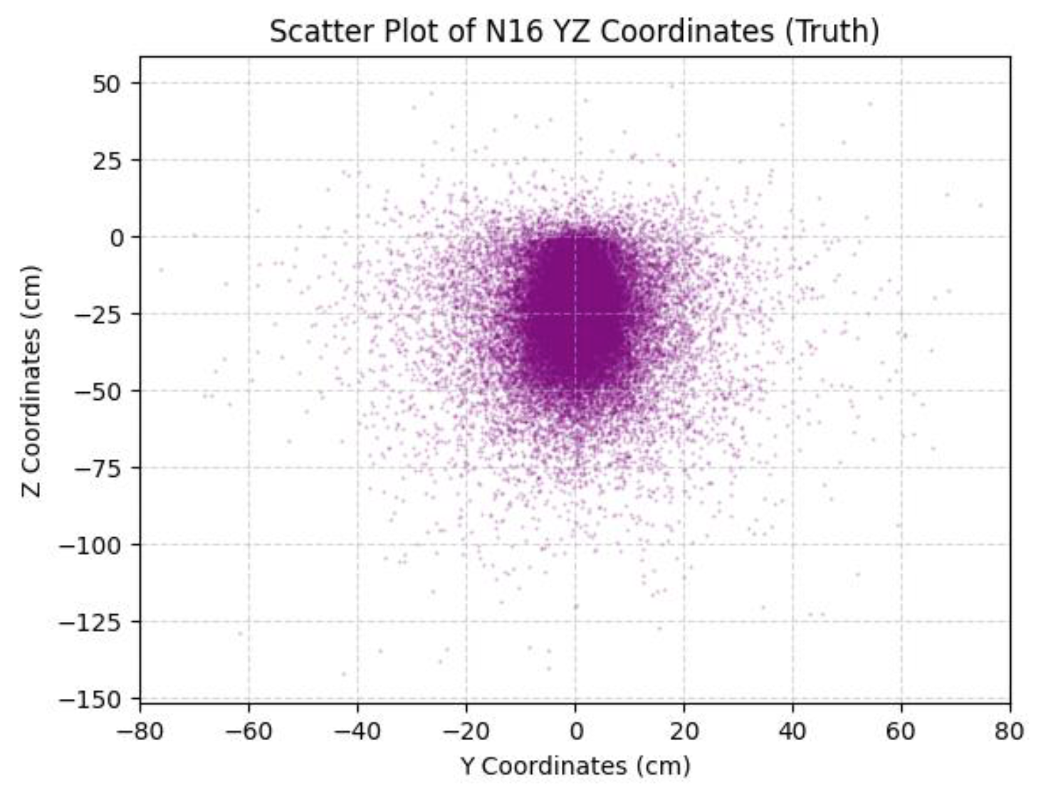
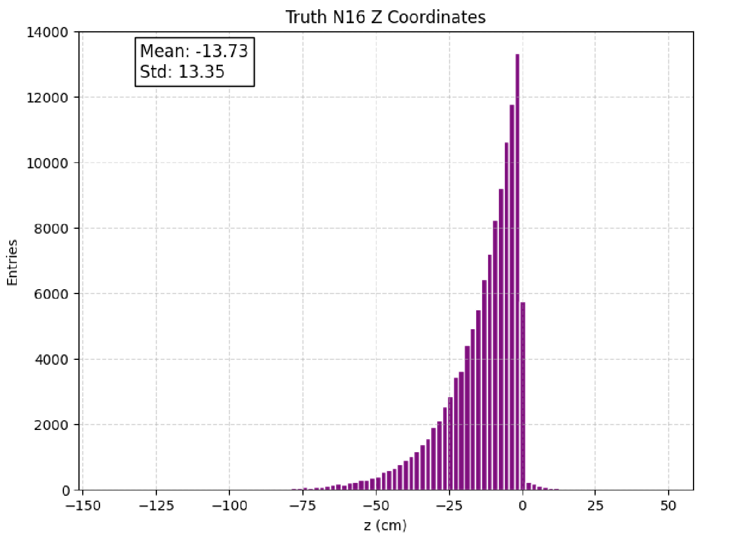
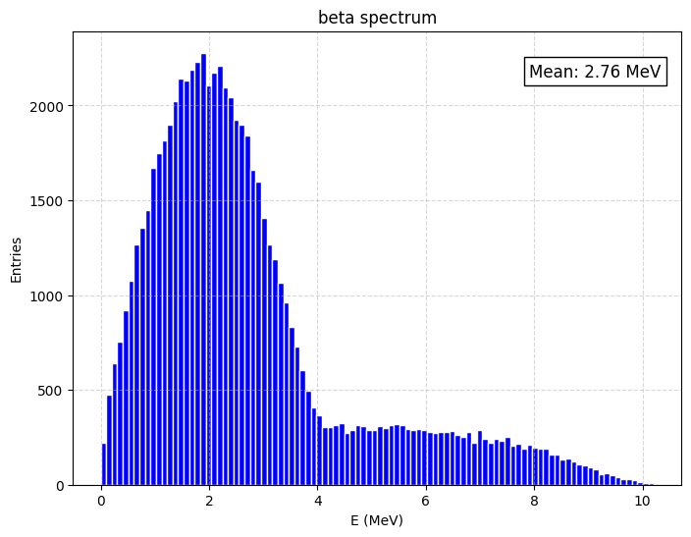
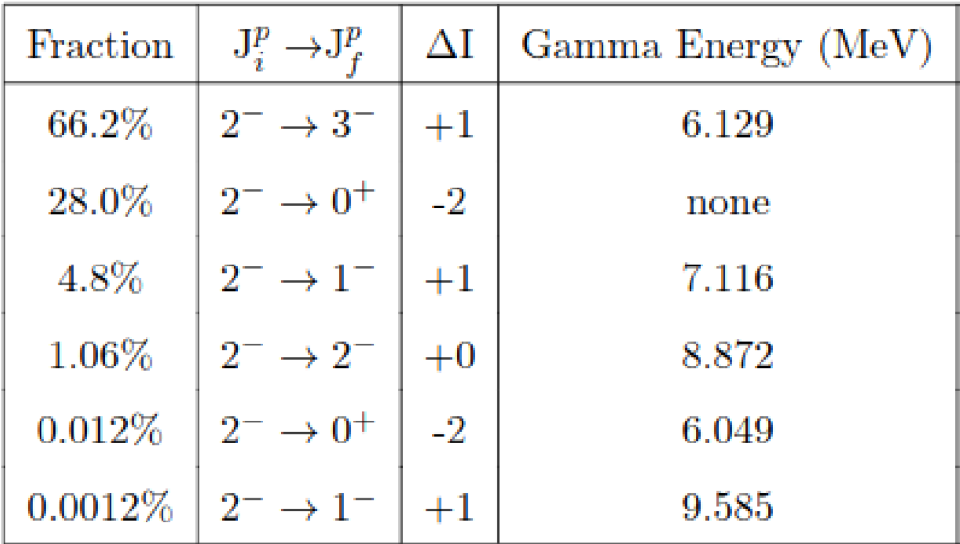
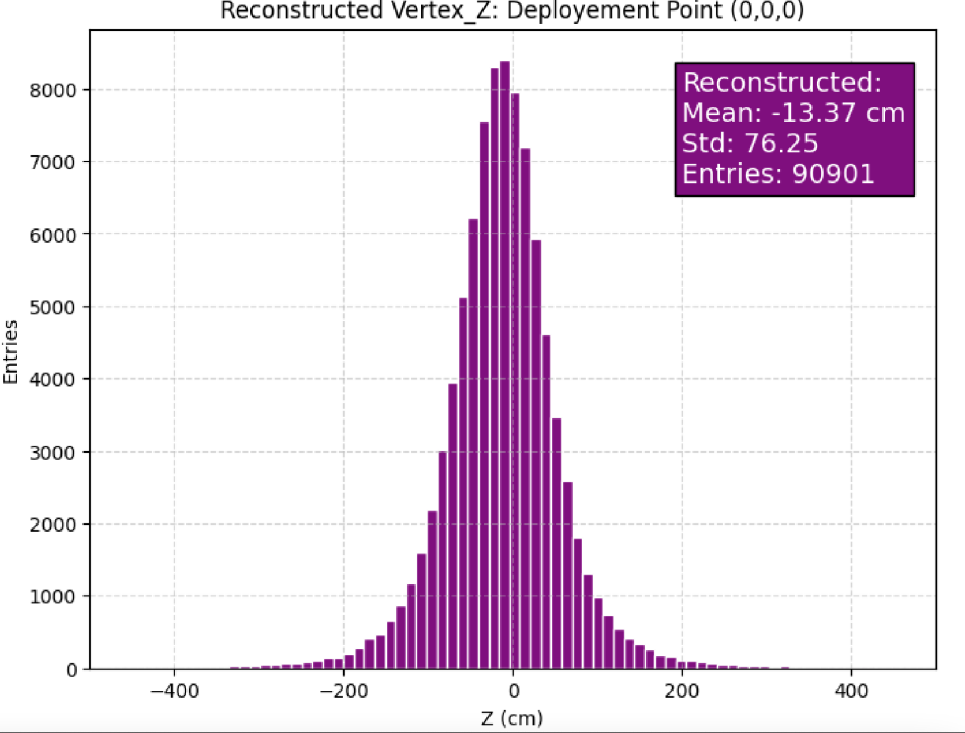
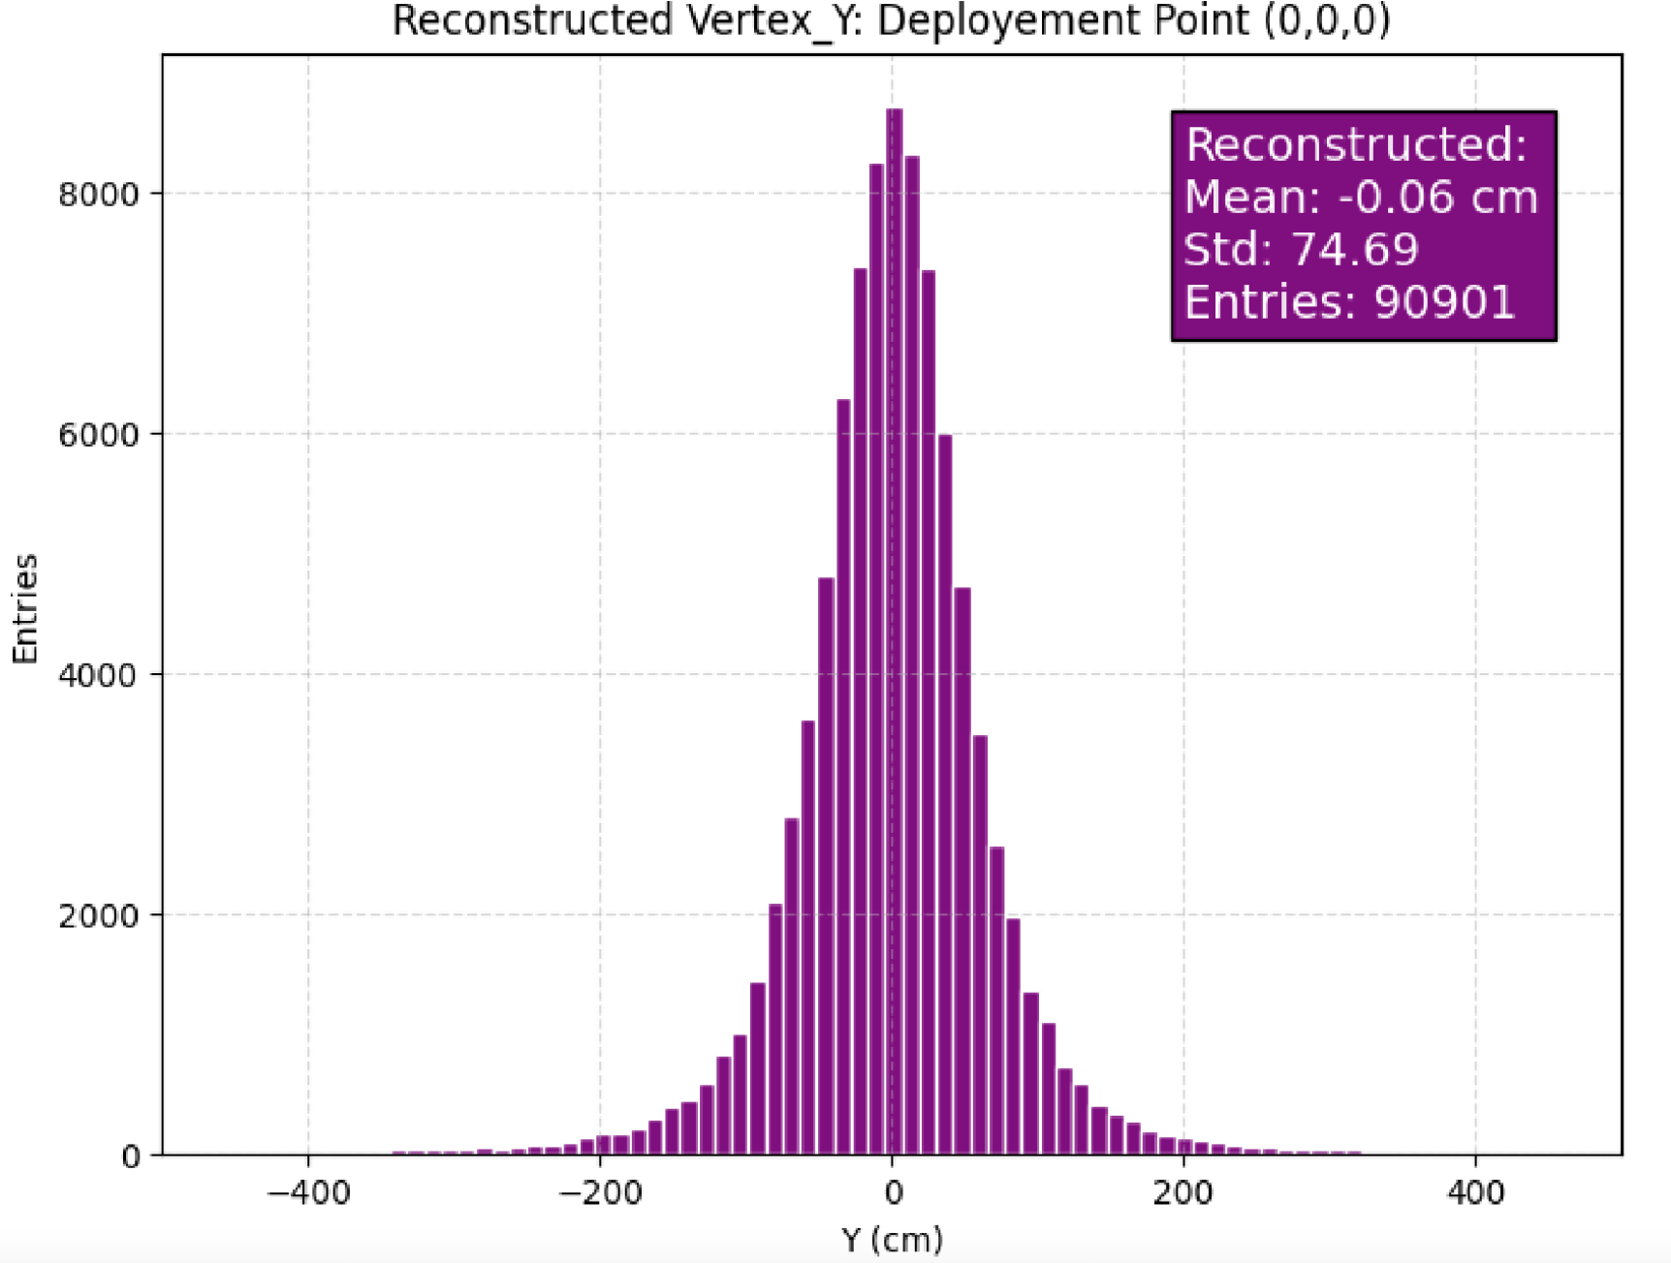
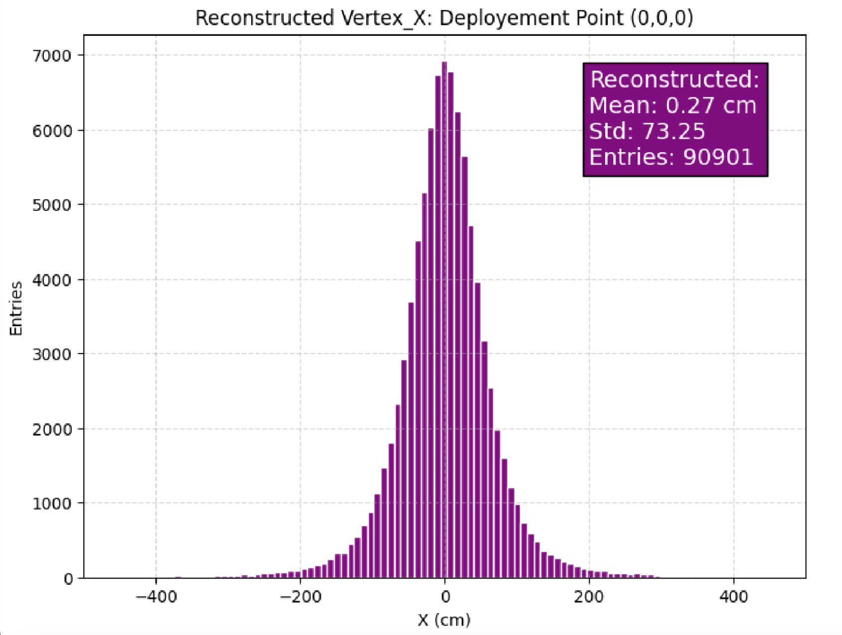
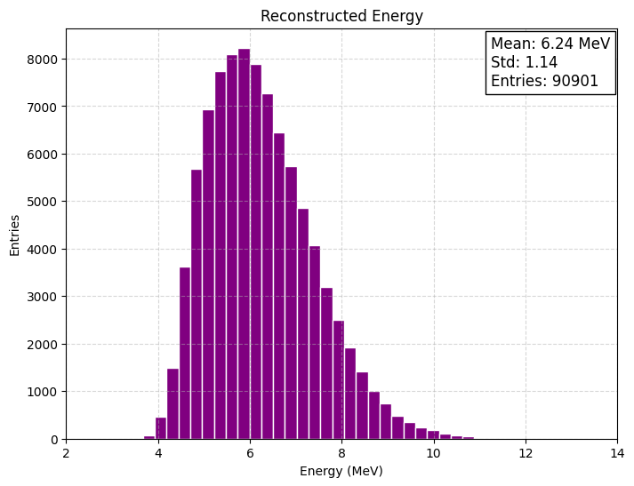
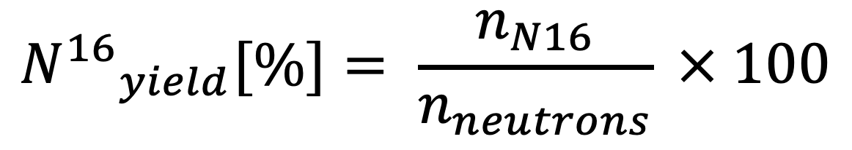
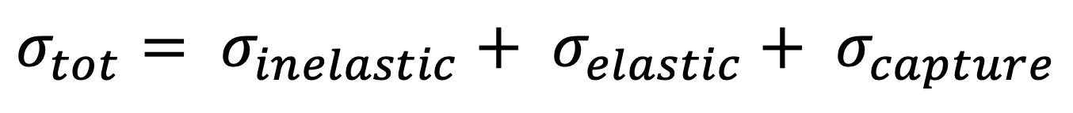
Energy scale cross-calibration of Hyper-Kamiokande detector using Deuterium-Tritium neutron generator
Abderrazaq El Abassi; Rafik Er-rabit, Mohamed Gouighri
Hyper-K
Deuterium-Tritium neutron generator
DTG deployment
Hyper-Kamiokande detector
is a next-generation long
baseline neutrinos experiment
expected to start taking data in 2027
The DTG generates neutrons by colliding deuterium and tritium ions with a fixed metal hydride target, containing equal parts of deuterium and tritium.
DTG is a low energy cross calibration system.
Used to generate an N16 cloud inside the inner detector:
¹⁶₈O + ¹₀n → ¹₀n + ¹⁶₇N
Deuterium-Tritium neutron generator is used to cross check the energy scale
DTG overcome some limitations of LINAC, such as isotropy and lower dead time, and lower shadowing effect.
²H + ³H → ⁴He + n
This N16 cloud beta decays isotopically:
¹⁶N → ¹⁶O* + ν̅ + e
DTG device will be deployed through several calibration ports into different depths per port.
After firing the neutrons, the device will be raised above the source before data taking to minimize shadowing effect.
¹⁶N is created by a neutron capture on ¹⁶O, and used as a source of calibration^{[1]} to be compared with LINAC calibration and combine both results to evaluate the total absolute energy scale.
The neutron generator can be pulsed at maximum rate of 100 Hz, with each pulse yielding approximately 10⁶ neutrons.
Neutron activation simulation^{[1]}
¹⁶N yield[%] and total cross section
GEANT4 simulation of a 4x4x4 m³ box of water
• Number of simulated
neutrons: 5M
• Neutrons energy: 14.2 MeV
• Orientation: at the origin (0,0,0) directed towards -Z axis with an opening angle of 15 degrees.
expected ¹⁶N yield is 2.3%, while
Super-K^{[1]} results found 1.3% and 1% observed in their data.
Visualization of generated neutron tracks in water
$$σ_{tot}= σ_{inelastic}+ σ_{elastic}+ σ_{capture}$$
Capture cross section on ¹⁶O on agreement with ITER measaurement^{[2]}
$${N^{16}}_{yield}[\%]= \frac{n_{N16}}{n_{neutrons}} × 100$$
Preliminary results: ¹⁶N MC truth position
Preliminary results: ¹⁶N properties
WCSim^{[4]} :¹⁶N x and y, z positions, the neutrons were directed towards –z
¹⁶N properties and beta spectrum
The mean distance traveled by neutrons before ¹⁶N creation is 15.47 cm
¹⁶N samples are used as input
for WCSim^{[4]} toolkit
Mean time before ¹⁶N creation is 3.08 ns
27.7% of ¹⁶N will decay directly to the ground state of ¹⁶O. The 6.129 MeV gamma ray is dominant with a fraction of 67.2%.
The decay product is propagated throughout the detector Volume
¹⁶N beta decays plus a gamma particle coming from ¹⁶O dexcitation
¹⁶N -> ¹⁶O + e⁻ + ⊽_{e} + ɣ
Consistent with Super-K^{[1]} results
Preliminary results: Reconstructed vertex and energy
Electron energy is less than 4.3 MeV
BONSAI^{[4]} recconstruted vertex, and FLOWER^{[4]} reconstructed energy
• The peak of energy is around 6 MeV which corresponds to the dominant gamma ray.
• Above a certain threshold (between 5 and 6 MeV), the shape of the energy spectrum can be fit with a Gaussian.
• At lower energies, the distribution appears to be affected by a cut in the shape due to detector's efficiency.
Reconstructed mean values are close to truth mean values, 0.02 cm, 0 cm, and –13.73 cm for truth mean vtx_x, vtx_y, and vtx_z respectively. However, a wider distribution spread due to the resolution of the detector is observed, where $\frac{σ_{reco}}{σ_{truth}}$ is around 14
Conclusions
References
Preliminary results indicates that the water activation simulation
and ¹⁶N decay have been achieved, In particular, our ¹⁶N yield appears to be higher when compared to previous
Super-K^{[1]} result.
The reconstructed energy is dominated by 6.1 MeV gammas in coincidence with 4.3 MeV electron endpoint energy
Next step is to reproduce the SK^{[1]} results, adapt the simulation to HK environment, and identify a calibration strategy for deployment locations.
[1] Super-K collaboration: ¹⁶N as a calibration source for Super-Kamiokande : https://doi.org/10.1016/S0168-9002(00)00900-1
[2] M.Pillon: Measurement of the ^{16,17}O(n,p)^{16,17}N cross sections for validating the water activation experiment for ITER at the Frascati neutron generator: https://doi.org/10.1016/j.nima.2021.165107
[3] J.k.Bienlein: the half life of ¹⁶N: https://doi.org/10.1016/0029-5582(64)90202-0
[4] HK software: Water Cherenkov Simulation built on top of Geant4; BONSAI and FLOWER are reconstruction algorithms : https://github.com/WCSim/WCSim
higgstan.com: https://higgstan.com

